Slide 1
Course: MOBI8001 - Mobile Technology and Cloud Computing
Period: March 2017
Sensor Mobile Cloud Computing
Session 09
D5627 – I Gede Putra Kusuma Negara, B.Eng., PhD

Slide 2
Outline
Introduction
Wireless Sensor Network
Sensor Cloud
Sensor Mobile Cloud Computing
Urban Sensing
Application
Challenges
Conclusion
Bina Nusantara University

Slide 3
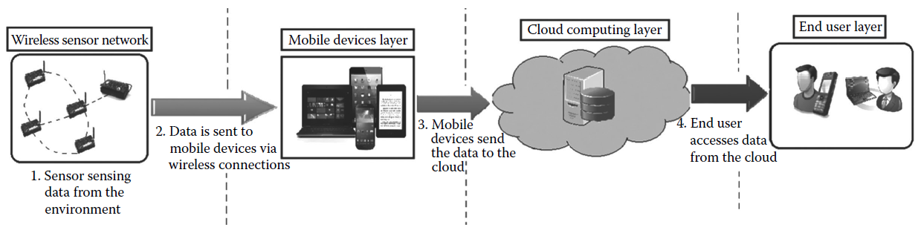
Introduction
Sensor mobile cloud computing (SMCC) is an integration of wireless sensor network (WSN) with mobile cloud computing (MCC)
Main problems of WSN: limited processing power, battery life and communication speed.
Cloud computing aggregates sensor data, increases coverage, and provides scalable processing power.
Sensor cloud is an integration of WSN with the data center model of cloud computing.
To extend the services of a sensor cloud, mobile devices can be integrated with it and this infrastructure is known as sensor mobile cloud computing (SMCC)
Bina Nusantara University

Slide 4
Wireless Sensor Network
A sensor network is composed of a large number of sensor nodes that are densely deployed over a geographical area.
WSN nodes are comprised of four basic components:
  a low-power sensing device: monitoring a wide variety of conditions
  an embedded processor: collecting and processing sensory signal
  a wireless communication subsystem: transmitting data
  a power module: battery with a limited energy level
Deployment of WSN:
  Regular deployment: data are routed through a predefined path.
  Random deployment: sensor nodes are scattered over a finite area.
Bina Nusantara University

Slide 5
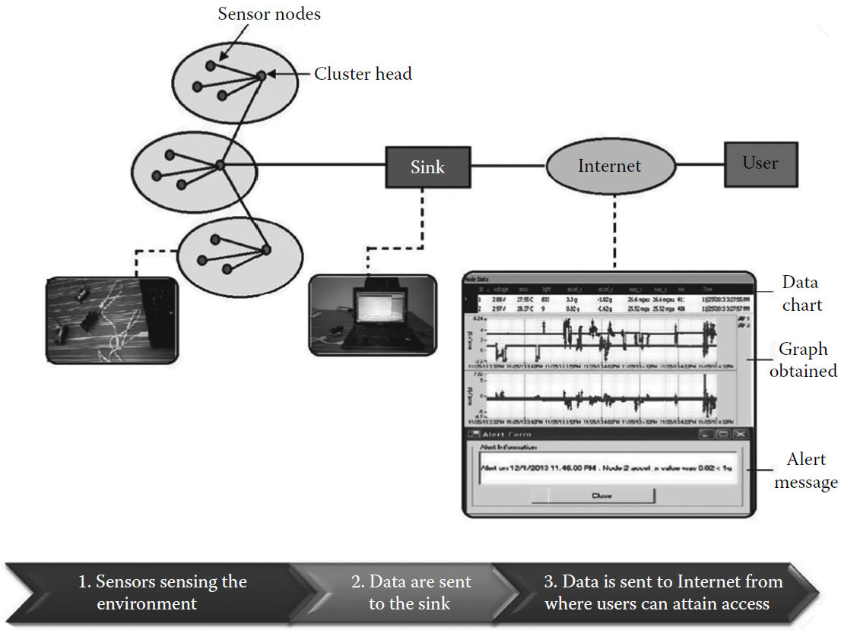
Wireless Sensor Network
Architecture of WSN
  Clustering to prolong
  network lifetime.
  Groups sensor nodes
  into cluster and set
  cluster heads (CH)
  CH gathers data from
  sensor nodes and
  sends aggregated data
  to sink or base station
  User accesses data
  from a remote place
  through internet
Bina Nusantara University

Slide 6
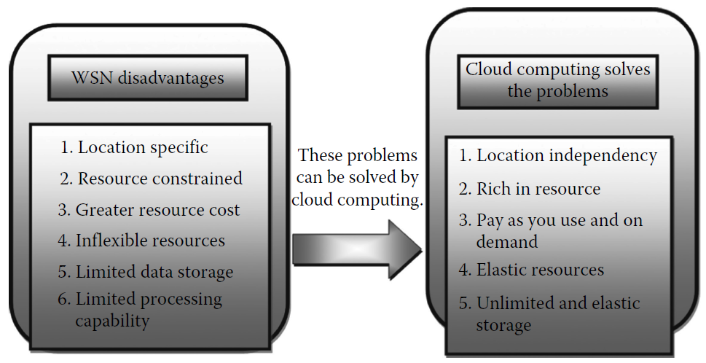
Sensor Cloud
Sensor cloud service architecture integrates cloud computing with WSN to overcome the obstacles faced by WSN and provides new and better facilities.
A sensor cloud accumulates and processes information sensed by several sensor networks, facilitates information sharing, and collaborates with the applications on the cloud among users.
Benefits of Sensor Cloud:
Bina Nusantara University

Slide 7
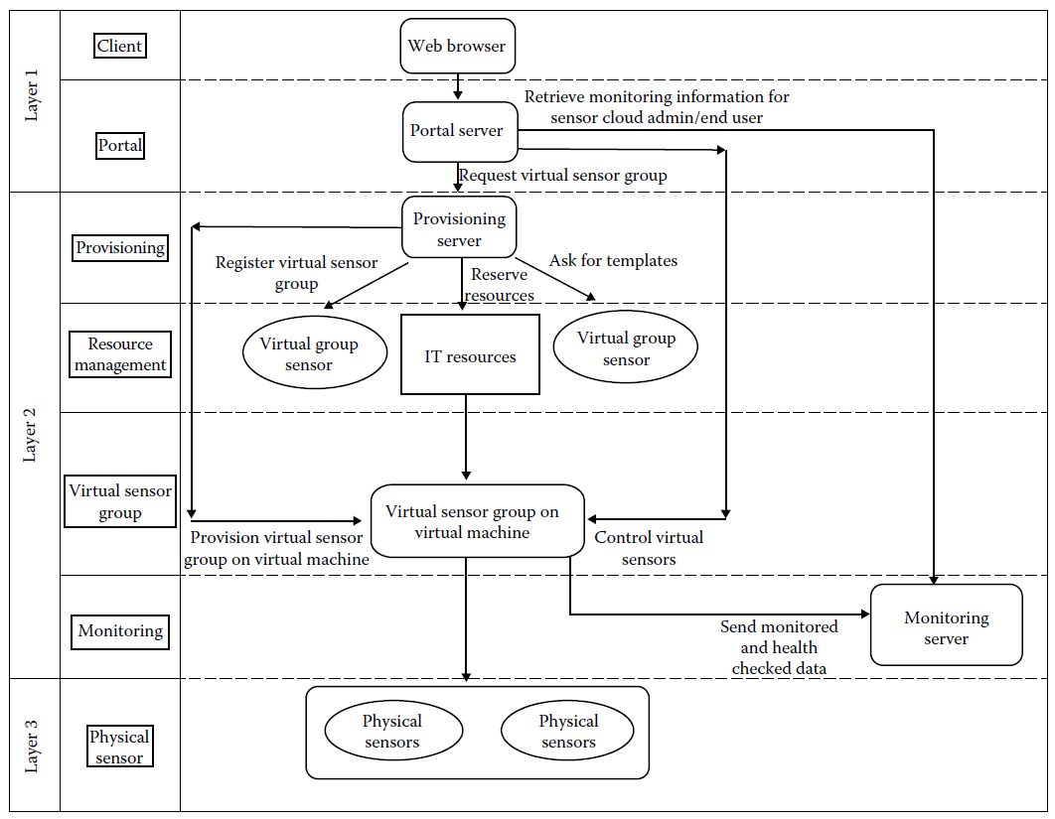
Sensor Cloud
Architecture of sensor cloud:
Bina Nusantara University

Slide 8
Sensor Cloud
Main components of sensor cloud:
  Client module: client layer is where end users can employ sensor cloud infrastructure by accessing the user interface through web browsers.
  Portal module: this module offers interfaces to the client to access the sensor cloud infrastructure.
  Provisioning module: this provides automatic provisioning of virtual sensor groups, in accordance with the user’s specific need.
  Resource management: server, storage, and so on, are the IT resources used for the virtual sensor and the templates for the provisioning module used in sensor cloud architecture.
  Virtual sensor group module: this layer is provided to help the user employ the physical sensor layer dynamically.
  Monitoring module: this layer monitors the virtual sensor layer and the cloud infrastructure.
  Physical sensor module: the sensors are used to sense the environment or a patient’s body, as the application requires.
Bina Nusantara University

Slide 9
Sensor Cloud
Main components of the layered architecture of sensor cloud:
  Login: the portal is logged into by the end user through a web browser.
  Select the templates of virtual sensor group: the portal wants the list of the templates of virtual sensors groups and virtual sensors from the database. The required template is selected by the end user from the list.
  Request the virtual sensor group: by selecting the templates on the portal, the end user requests the virtual sensor groups. The portal calls the provisioning server providing the input parameters (e.g., the template IDs, user ID, and the virtual group names).
  Reserve IT resource: the IT resources are first reserved by the provisioning server for the virtual sensor group and then, if there is no resource left on the existing virtual servers, a new virtual server is automatically provided with a monitoring agent, and the IT resource is reserved.
  Fetch the templates and provision: the templates of the virtual sensors and the virtual sensor group are obtained by the provisioning server from the database. The virtual sensor groups are provisioned on the virtual server being selected.
  Notify the completion: the end user is notified by the provisioning server of obtaining the virtual sensor group requested by e-mail. It also incorporates the latest records to describe virtual sensor groups.
Bina Nusantara University

Slide 10
Sensor Cloud
Layered architecture of sensor cloud:
  Layer 1 - Portal server:
  The portal server provides the web pages to the client browser for provisioning, for requesting or demolishing virtual sensor groups, for controlling those created templates of virtual sensors, for monitoring their virtual sensors, for checking their usage-related charges, and for logging in and logging out .
  Layer 2 - Provisioning server:
  The provisioning server takes initiatives to arrange the virtual sensor groups in response to requests from the portal server. Workflows are predefined and are controlled by a workflow engine. In a proper order, the workflows are executed. When the provisioning server receives a request from the client, the IT resource pool is checked first and reserved for further processing. The client uses virtual sensor groups through the templates. The server retrieves those templates and then provisions the virtual sensor groups. The job or definition of the virtual sensor groups is updated after provisioning, and agents are provisioned to monitor virtual servers.
  Monitoring server:
  The status of virtual sensors is watched by the monitoring server through the agents of the servers and the virtual servers. The received data relating to the status report are stored in a database. Through the web browsers, monitoring information about the virtual sensors is available to the client. The status of the servers is also monitored by the sensor cloud administrators.
Bina Nusantara University

Slide 11
Sensor Mobile Cloud Computing
Mobile devices are equipped with various sensors to sense data from environments or human body and send the aggregated data to the cloud through the internet.
Main reasons for the extension of sensor cloud to SMCC:
  Mobility: to handle computing and to establish connection with the Internet to send the data.
  Low power consumption: the mobile device consumes lower battery power than other devices, for example, limited energy availability on portable devices.
  Communication capabilities (pervasive): the mobile devices help establish wireless connection to access data from anywhere, anytime, or user profiles from host, and communication between users. Communication through voice, video calls, and massages is possible.
Bina Nusantara University

Slide 12
Sensor Mobile Cloud Computing
Main components of the SMCC architecture:
  Physical sensors: sensors are placed arbitrarily in various locations for monitoring. Different sensors are used in different applications.
  Mobile phone: sensor’s data are sent to the mobile phone via Bluetooth or ZigBee networks. A mobile phone collects the sensor data, processes the data, and transfers it to the cloud for further processing. Generally, Wi-Fi , 3D or 4G can be used to establish communication between a mobile and the cloud.
  Mobile network: Mobile phones send sensor data to the wireless application protocol (WAP) server placed in the mobile network. The particular user can be traced via the WAP server. Authentication, authorization, and accounting are controlled by mobile network operators based on home agent and the subscriber’s information stored in databases. The subscriber’s requests are delivered to the cloud through the Internet. The cloud provider processes the requests and sends them to the corresponding cloud services.
  System Manager: The system manager manages the cloud, which is connected to the WAP server through the Internet. System manager fetches data from the WAP server to process it in the cloud server, which allots IT resources before starting data processing. The cloud server runs the user application and computes the data collected from sensor nodes. There exist web portals through which the analyst can access results and provide appropriate decisions to the client for particular application.
Bina Nusantara University

Slide 13
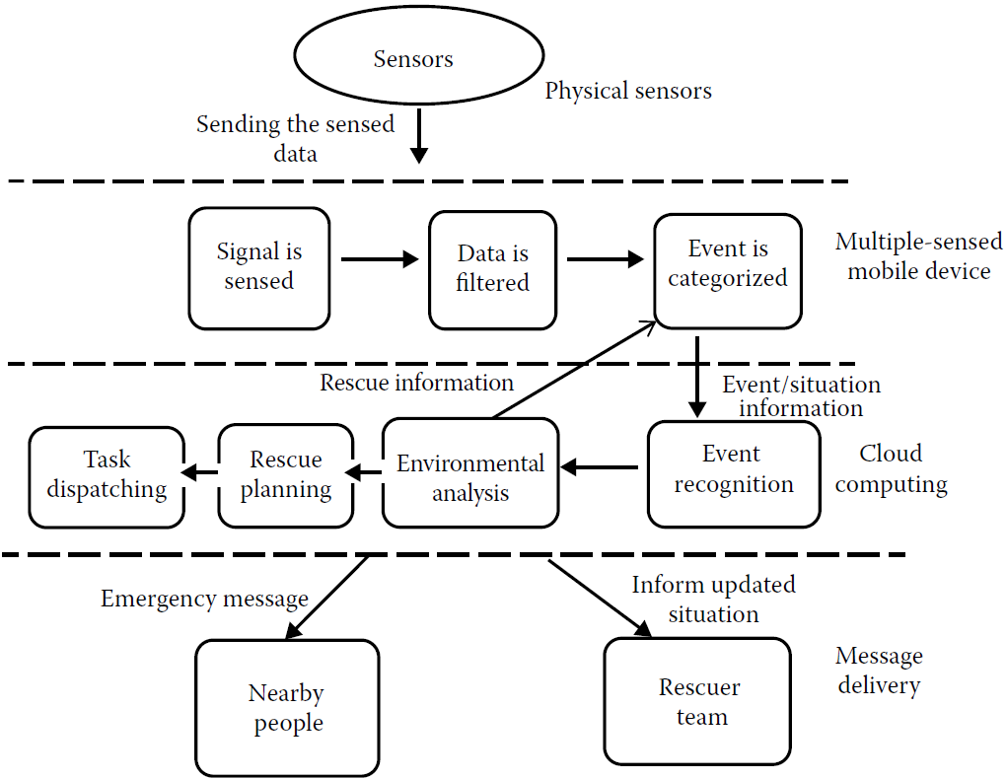
Sensor Mobile Cloud Computing
System Architecture for a Rescue Service Model:
Bina Nusantara University

Slide 14
Sensor Mobile Cloud Computing
Layers of the architecture for a Rescue Service Model:
Multiple-sensed mobile device: Multiple-sensed mobile devices can collect a wide range of sensing data from the environment or from the behavior of the people. To detect any emergency event, the sensed signals should be processed automatically. To extract meaningful information, these sensing data are filtered into the mobile. According to user-defined criteria, events are categorized and sent to the emergency cloud.
Emergency cloud: Since the information regarding an event from mobile devices is generated from a local perspective and may be incomplete as the sensing is done in an emergency situation, emergency cloud has to further recognize the complete event from a universal perspective. Then the environment within the range of the emergency event is analyzed with the collected data to support rescue planning and distribute rescue tasks to appropriate rescue units according to their work load and locations.
Nearby people: It is possible that somebody near the victims can provide instant help compared to distant rescue units in an emergency. Thus, the emergency message can also be broadcast to nearby people. Sometimes, prediction of an evacuation process from the disaster area can be broadcast as the emergency message to people in the locality.
Rescuer: Mobile devices will keep updating information about the situation of people in the disaster area and send such information to the cloud in emergency service. The information about the situation is also analyzed and updated to provide urgent information to the rescue units.
Bina Nusantara University

Slide 15
Urban Sensing
Urban sensing uses mobile phone network data, such as the types of activities in different parts of the city, residential and working areas, population distribution, and commuting patterns.
People-centric urban sensing involves collecting data associated with people, such as their immediate surroundings, their characteristics, and the way they interact with their surroundings
People are involved not only as consumers of collected data but also as collectors of data
Bina Nusantara University

Slide 16
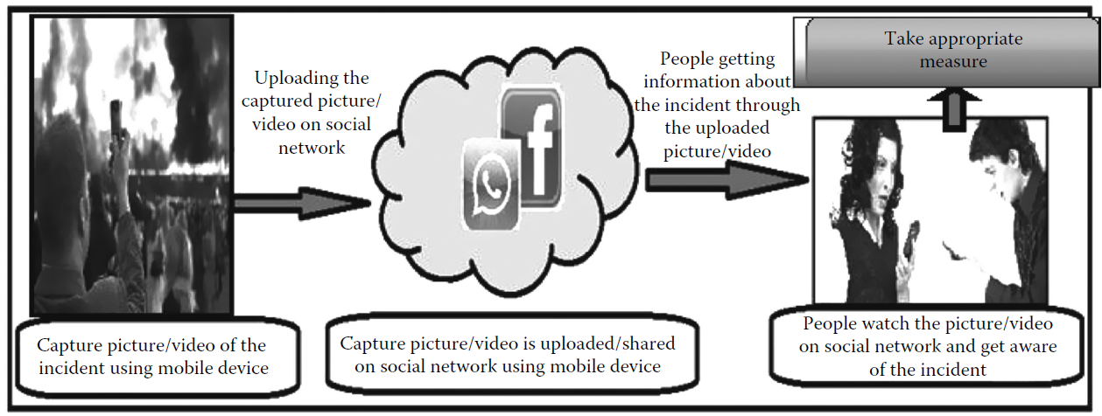
Urban Sensing
Opportunistic Sensing:
  Data collection is automatic without user participation
  (user may not be aware of active applications)
  System designers should carefully make a system that is only activated if predefined conditions have been satisfied.
  Data quality is low and suffers from high data-miss rates
Bina Nusantara University

Slide 17
Urban Sensing
Participatory Sensing (PS):
  People take part directly in the sensing loop
  Sensing tasks by mobile sensors are triggered manually
  High data quality is assured
  PS is based on preplanned and simplified system, as complex operations are solved by the intelligence of the person
  The applications are specific in nature
  PS enhances the basic application with real-time updates that allow the crowd to collect the required data.
Bina Nusantara University

Slide 18
Application
SMCC can be introduced in a conventional healthcare system
The traditional scenario of health care:
  A nurse or other medical staff collects patient’s data and writes the information down on paper.
  Notes are submitted to a terminal for data entry.
  The collected data are stored in a database server where they are organized, indexed, and able to be accessed through an interface.
  Doctors and medical staff are able to access this information through an interface of any application.
Main drawbacks:
  latency between data gathering (1) and information access (4)
  real-time monitoring of a patient is not possible
  data inaccuracy during data entry.
Bina Nusantara University

Slide 19
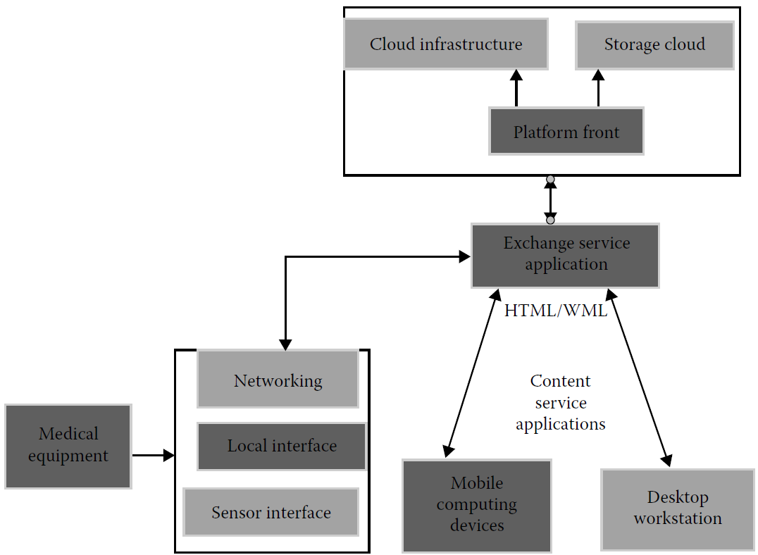
Application
Architecture of a healthcare system using SMCC
Bina Nusantara University

Slide 20
Application
Main components of the health service model:
  Sensor module: physical health sensors are used to measure the blood pressure, ECG, temperature, and other parameters. These data are extracted, transformed, and loaded from the sensor to the attached medical equipment. Software is loaded into the equipment to collect and process data locally. Then, the data are transmitted over the wireless network to “cloud services”.
  Exchange service application: This module organizes the patient’s overall data related to the disease. It acts as a broker between the local medical equipment and the remote cloud services.
  Content service application: These are the common interfaces used to provide information to doctors and other medical staff.
  Utility computing provider: This module is responsible for providing physical infrastructure to store data, processing, and content delivery services.
Bina Nusantara University

Slide 21
Application
Advantages of the SMCC scenario:
  This model facilitates continuous real-time data collection.
  Human interruption is eliminated and there is no possibility of erroneous data collection and data transmission to the database.
  Wireless sensors are easily deployed, as there is no fixed architecture of sensor network. Sensors attached to medical devices obviate the necessity of manual data gathering and data entry on the medical system.
  Computer resources available in the cloud are responsible for organizing, indexing, making the data accessible, and distributing the data to doctors and medical staff.
Bina Nusantara University

Slide 22
Challenges of Sensor Mobile Cloud Computing
Wireless communication: lower bandwidths, higher error rates,
and higher latency.
Challenging software development
Poor resources in mobile devices
Low power and finite energy resources
Costing and charging issues of cloud computing: higher cost of data communication
Security issues: data loss, phishing, botnet
Data availability: dependent on internet access for communication
Bandwidth variation is high
Various networks: change networks as they move beyond the range
of the network in use
User interface is small due to the small screen.
Bina Nusantara University

Slide 23
Conclusion
Integrating sensors with MCC provides an open, extensible, scalable, interoperable, reconfigurable, and easy-to-use network of sensors for numerous applications.
Using SMCC, the situation of every person in a city can be traced, and gradually the city becomes a smart city.
SMCC still faces many challenges such as power management, wireless communication, security, user interface, etc.
Bina Nusantara University

Slide 24
References
Debashis De. (2015). Mobile Cloud Computing: Architectures, Algorithms and Applications. 01. Chapman and Hall/CRC Press. Florida. ISBN: 9781482242836. Taylor & Francis Publishing ISBN- 978–0–203–88776–9
W. S. Ansari, A. M. Alamri, M. M. Hassan, and M. Shoaib, A survey on sensor-cloud: Architecture, applications and approaches, Int. Jour. of Distributed Sensor Networks, 2013, 1–18.
M. Yuriyama and T. Kushida, Sensor-cloud infrastructure—Physical sensor management with virtualized sensors on cloud computing, in 13th Int. Conf. on Network-Based Information Systems, pp. 1–8, 2010.
Y. J. Chen, C. Y. Lin, and L. C. Wang, Sensors-assisted rescue service architecture in mobile cloud computing, in Wireless Communications and Networking Conf., pp. 4457–4462, 2013.
N. D. Lane, S. B. Eisenman, M. Musolesi, E. Miluzzo, and A. T. Campbell, Urban sensing systems: Opportunistic or participatory? in Proc. of the Ninth Workshop on Mobile Computing Systems and Applications, pp. 11–16, 2008.
C. O. Rolim, F. L. Koch, C. B. Westphall, J. Werner, A. Fracalossi, and G. S. Salvador, A cloud computing solution for patient’s data collection in health-care institutions, in Second Int. Conf.e on eHealth, Telemedicine, and Social Medicine, pp. 95–99, 2010.
Bina Nusantara University

